Slide 1
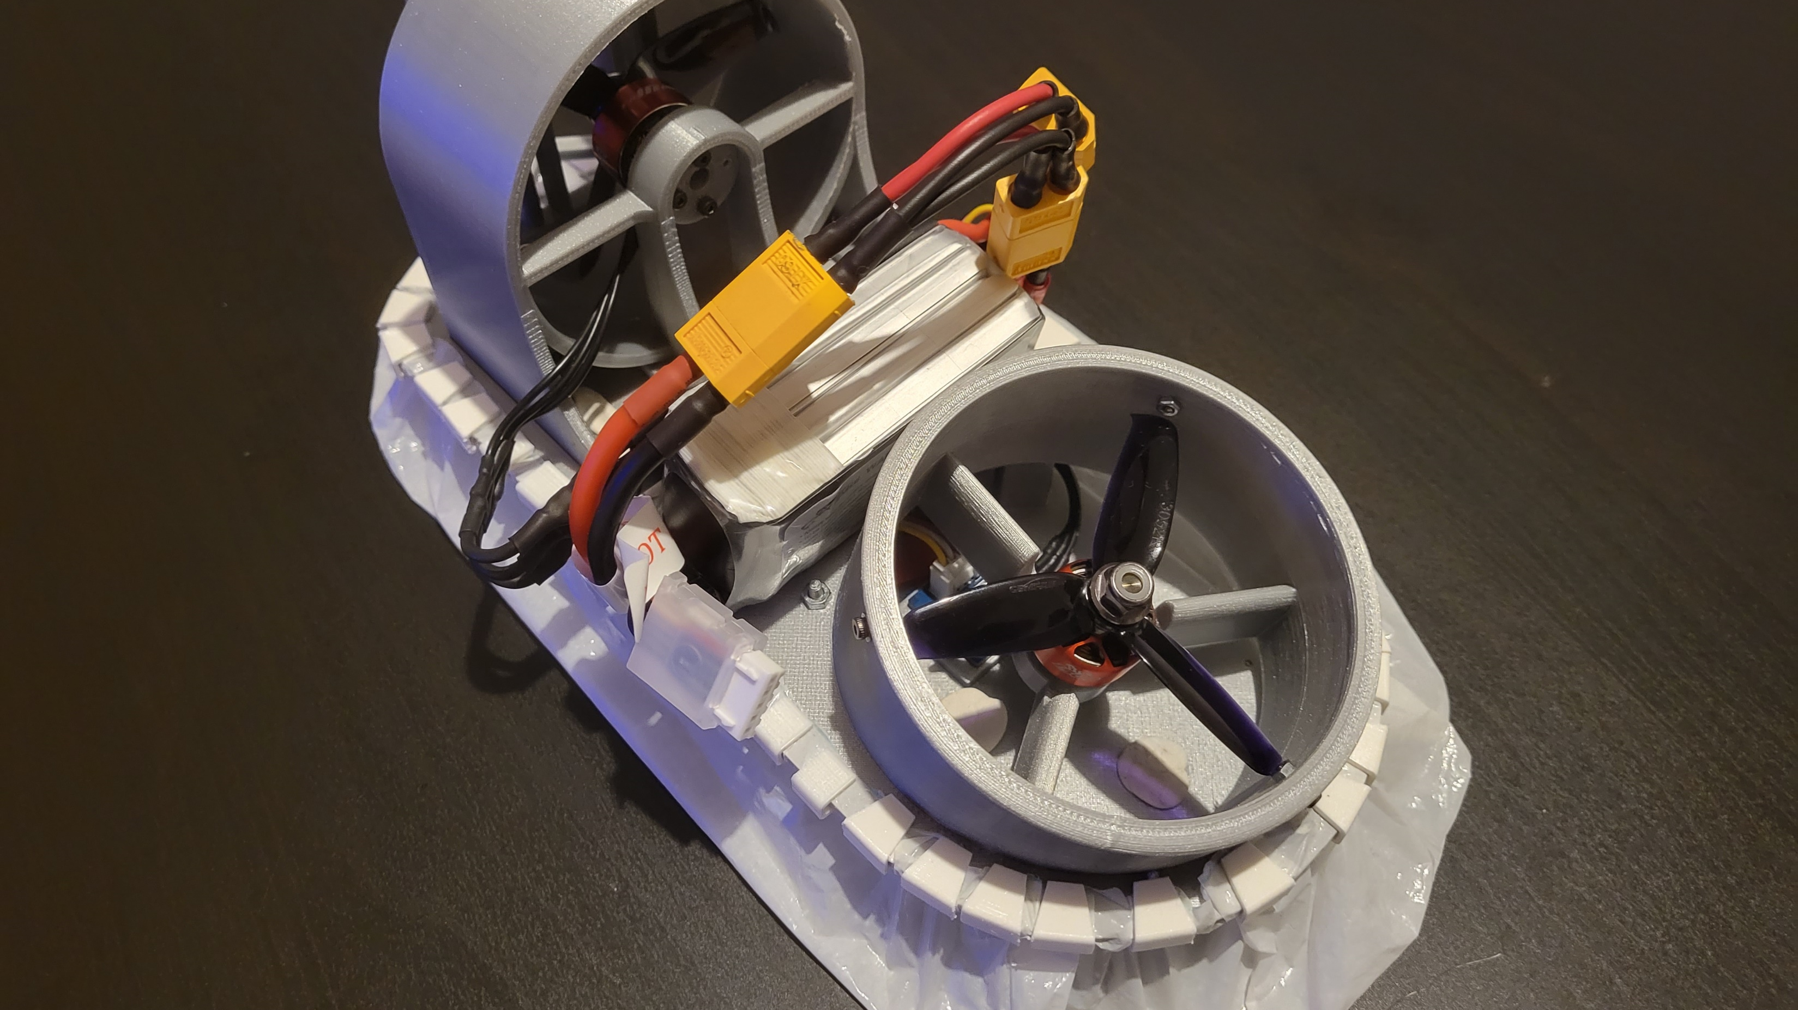


Hovercraft Project
Introduction : 2-Stage Project
Stage 1
Stage 2
The initial phase, which we undertook, focused on laying the foundation for the project. This included clarifying the project's objectives, identifying key challenges, and creating a working prototype.
The second phase, planned for future development, will focus on advancing the hovercraft's capabilities to achieve autonomous operation
By Christophe BARBAUT & Romuald BAUDRI

Slide 2
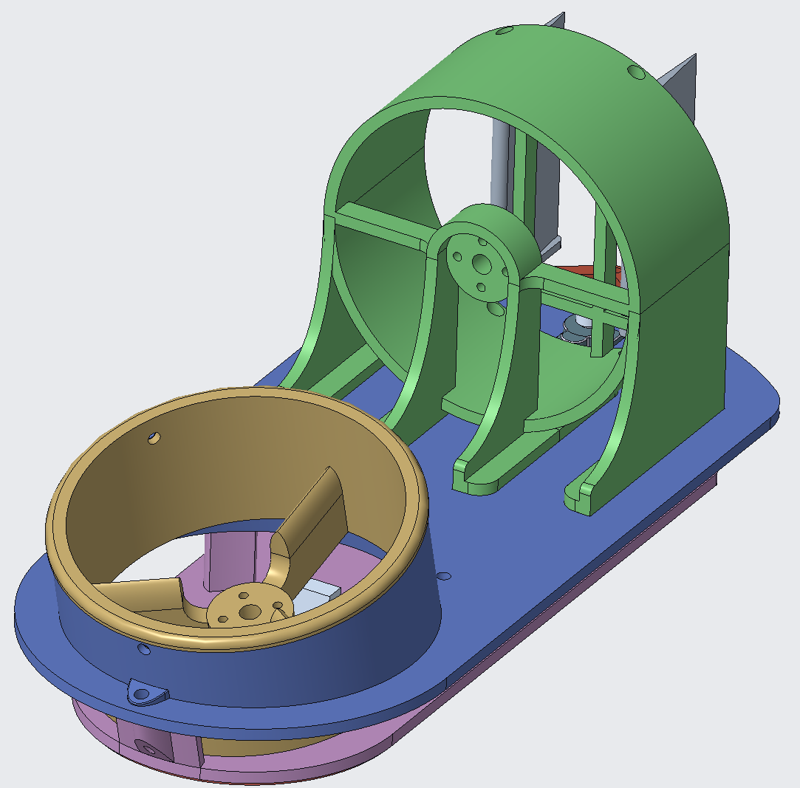
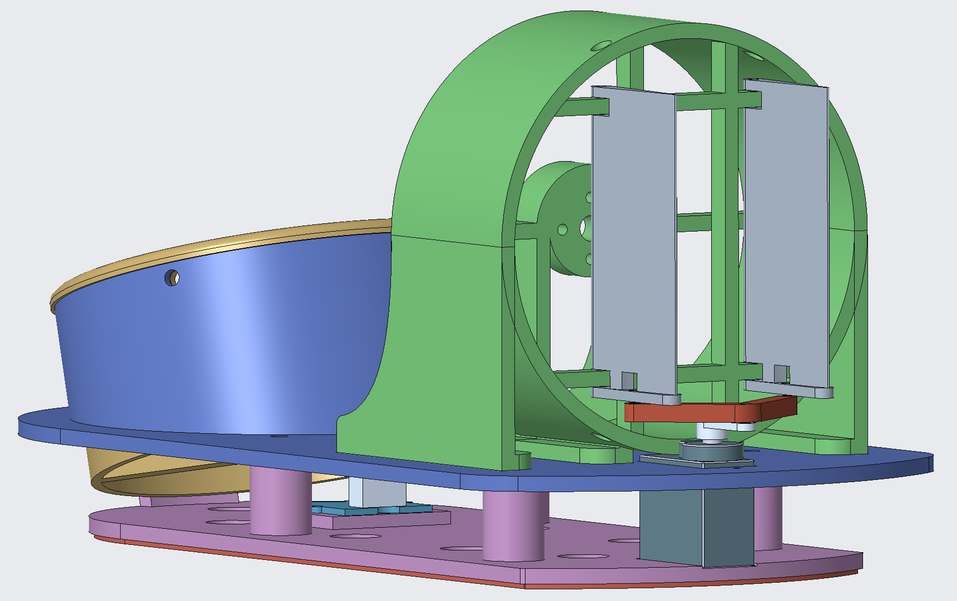


Introduction : 2-Stage Project
Development CAD design, 3D printing and component integration
v
Stage 1
Stage 2
The initial phase, which we undertook, focused on laying the foundation for the project. This included clarifying the project's objectives, identifying key challenges, and creating a working prototype.
The second phase, planned for future development, will focus on advancing the hovercraft's capabilities to achieve autonomous operation
Notes:
Stage 1 :
The primary goal of this phase was to establish proof of concept by developing a manually controlled hovercraft capable of stable movement and basic functionality.
Stage 2 :
This includes integrating advanced sensors, navigation algorithms, and control systems to enable the hovercraft to operate independently, avoiding obstacles, and following predefined paths.

Slide 3
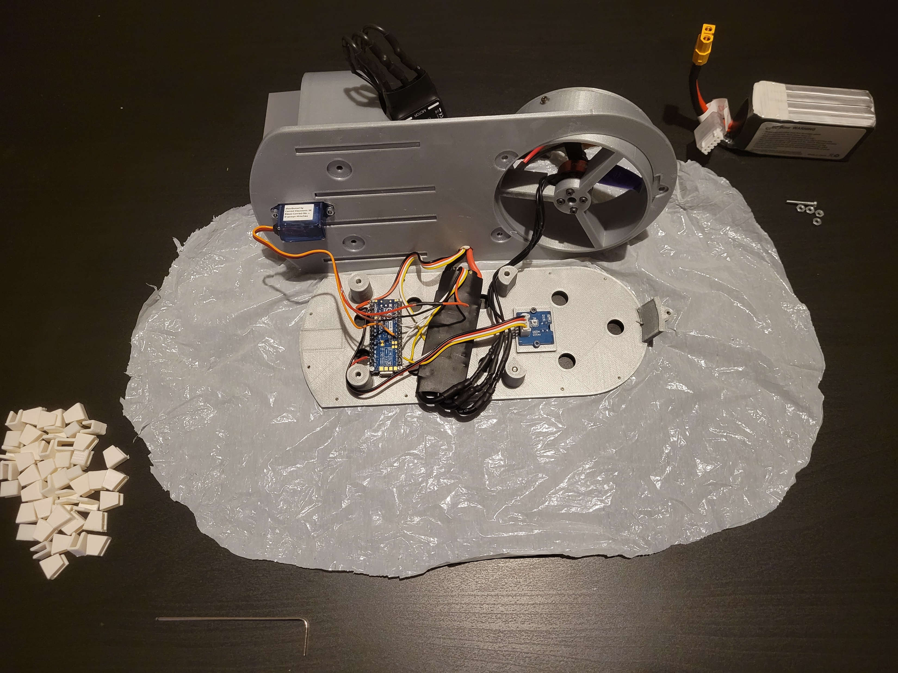
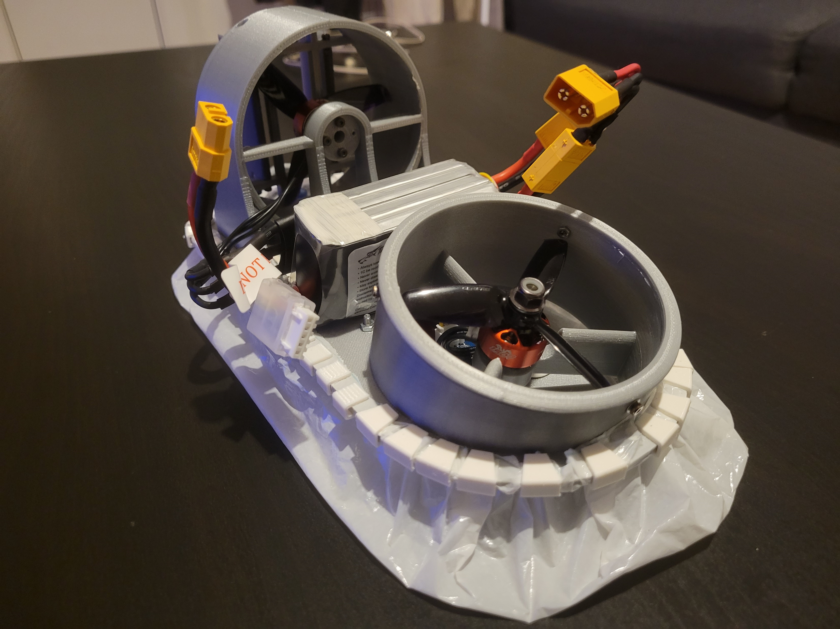
Development CAD design, 3D printing and component integration
Prototyping Adjustments and assembly
Notes:
The development phase was for me one of the most challenging and rewarding parts of the project. It involved designing the hovercraft, with all the constraints of manufacturing the hovercraft using 3D printing and integrating all the electronics.
CAD Design:
The hovercraft's CAD model was inspired by existing projects but entirely redesigned to meet our specific constraints which was to make it as small as possible (20 cm long) while integrating all the components. And as we search on internet this has never be done
So as I said the goal was to 3D Print:
3D printing gave us great flexibility to create complex shapes and rapidly test designs.
However, we had to account for manufacturing tolerances, which required several iterations to ensure proper fitting.
During the design phase, I had to constantly think about the integration of the components.:
The hovercraft was designed to accommodate motors, ESCs, InfraRed sensor, an Arduino, a batterie, a servomotor and all the wiring.
Electronic Stability Control : ESC. Basically, the ESC delivers the right amount of battery power to the motor.

Slide 4
Prototyping Adjustments and assembly
1. Hardware Initialization and Basic Component Testing
Arduino Code
01
06
The project began with setting up the Arduino Nano 33 BLE Rev2 and testing individual components, such as servomotors.
6. Code Optimization and Final Testing
The final step refined the code for stability, safety, and ease of use. The completed code provided manual control of the hovercraft with efficient motor and servo management.
02
2. Development of BLE Communication
The second step focused on establishing a reliable BLE connection between the Arduino and the mobile application.
5. IR Sensor
A basic sensor system was added, including an IR line-following sensor.
05
4. Component Integration and Multi-Device Management
03
04
3. Electronic Speed Controller (ESC) and Motor Integration
This step combined all major components: propulsion motors, lift system, and steering servomotor.
ESCs were calibrated to interpret PWM signals from the Arduino, controlling the hovercraft’s brushless motors for propulsion and lift.
Notes:
After that was the prototyping phase where theory met reality. And it was quite good but not pixel perfect. We assembled the hovercraft, tested it, and made adjustments based on the issues we discovered.
Assembly:
The assembly involved soldering and wiring the components, where Christophe helped me, screwing the 3D-printed parts together, and attaching the skirt with clips.
We've come up against a few problems that we've solved. If you're curious, we can come back to this at the end.
Issues:
One major issue was the size of the ESCs, which were larger than anticipated. This forced us to place one ESC on top with the battery instead of both at the bottom.
Manufacturing fault with the frame (thinner on one side). So we had to make smaller clips to hold the skirt.
Fragile rudders
Difficulty screwing in. I made a mistake in sizing some of the holes. This caused a slight misalignment when fitting the motors.

Slide 5



Arduino Code
Mobile Application
• BLE connection for remote control.
6. Code Optimization and Final Testing
1. Hardware Initialization and Basic Component Testing
06
01
The final step refined the code for stability, safety, and ease of use. The completed code provided manual control of the hovercraft with efficient motor and servo management.
The project began with setting up the Arduino Nano 33 BLE Rev2 and testing individual components, such as servomotors.
5. IR Sensor
02
• Virtual joysticks for propulsion and steering.
05
A basic sensor system was added, including an IR line-following sensor.
2. Development of BLE Communication
The second step focused on establishing a reliable BLE connection between the Arduino and the mobile application.
4. Component Integration and Multi-Device Management
04
03
3. Electronic Speed Controller (ESC) and Motor Integration
• Improved user interface through multiple iterations
This step combined all major components: propulsion motors, lift system, and steering servomotor.
ESCs were calibrated to interpret PWM signals from the Arduino, controlling the hovercraft’s brushless motors for propulsion and lift.
Notes:
1 - A basic program was written to move the servo between predefined angles, verifying compatibility and ensuring hardware functionality.
2 - Services and characteristics were configured to send and receive data wirelessly, enabling remote control of the hovercraft. This step also involved debugging connection stability and communication speed.
3 - A key focus was on ensuring smooth acceleration and power transitions, adding safety features to prevent motor damage and improve response.
4 - The code was expanded to process joystick inputs from the BLE app, translating them into commands for synchronized motor and servo control.
5 - Although simple in this phase, it served as the initial framework for integrating feedback mechanisms into the system, setting the stage for future autonomous navigation.
6 - Signal ranges for ESCs were adjusted, initialization processes were secured, and debugging ensured reliable performance.
Bluetooth Low Energy (BLE) is a wireless communication technology designed for:
Main difference : communication between systems only when there is a data packet to send.
Low power consumption: Ideal for battery-powered devices.
Short-range communication: Typically 10-50 meters.
Data exchange: Used for small, intermittent data packets (e.g., commands, sensor readings).

Slide 6
Mobile Application
• BLE connection for remote control.
• Virtual joysticks for propulsion and steering.
• Improved user interface through multiple iterations

Slide 7
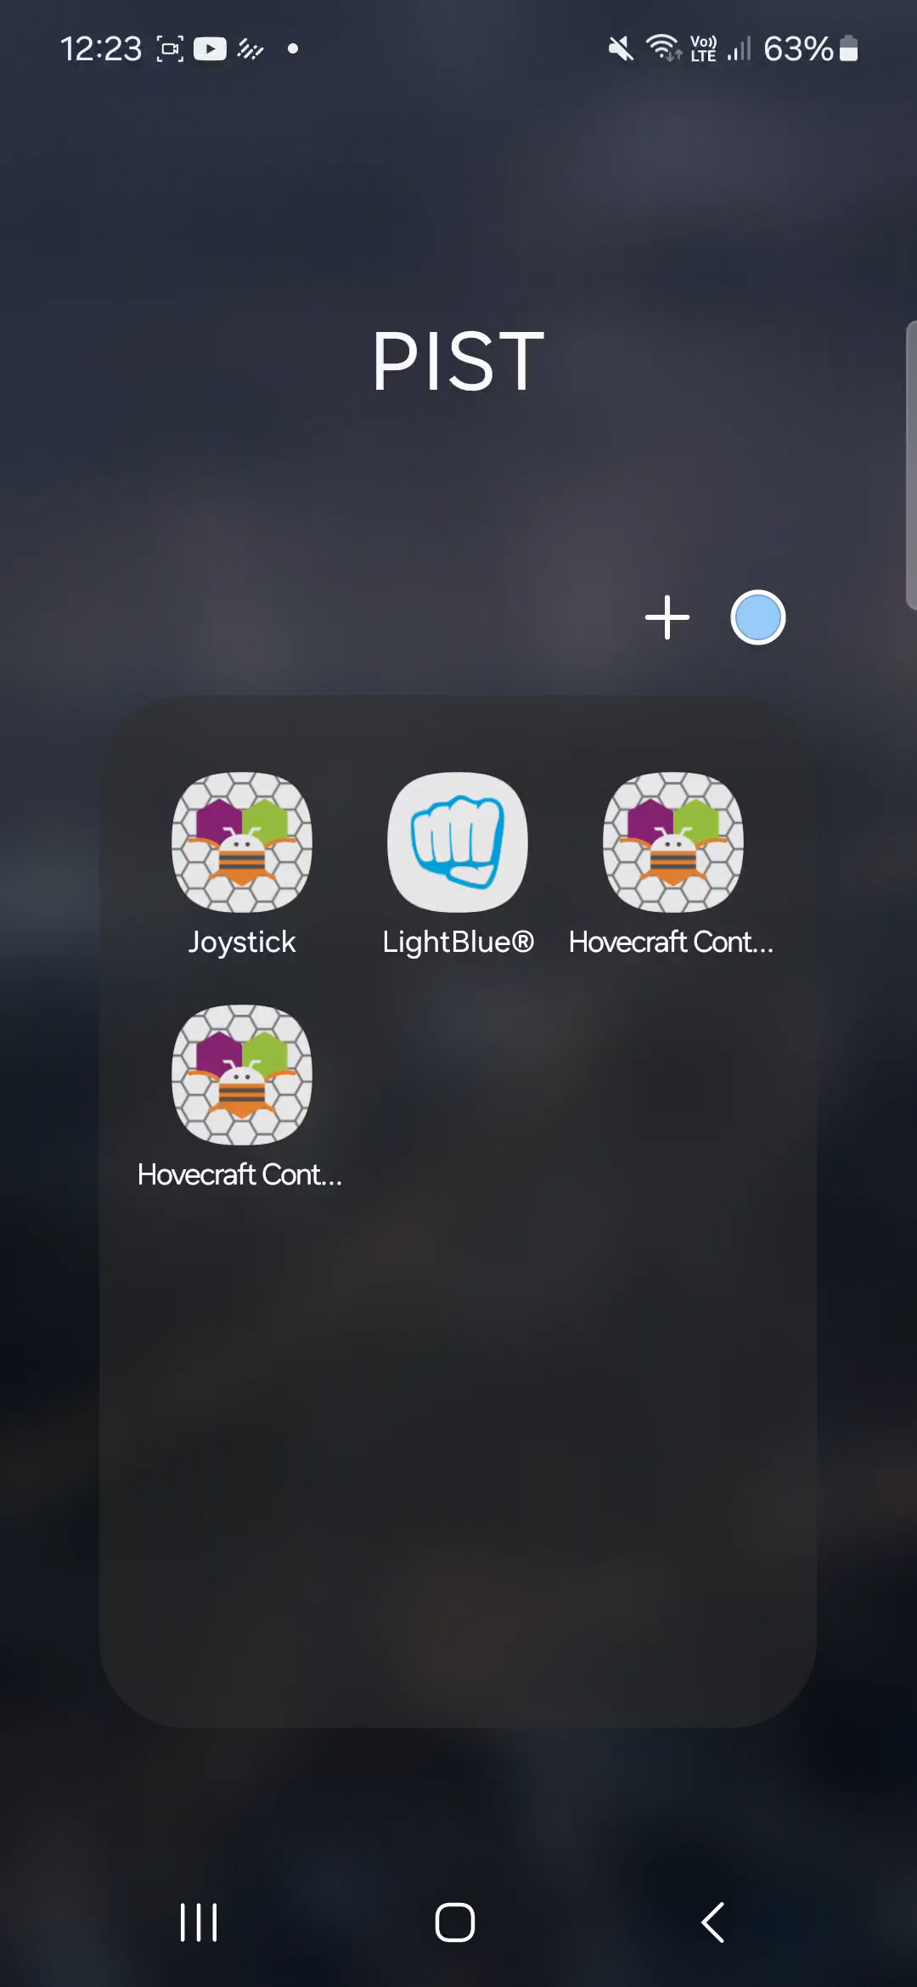
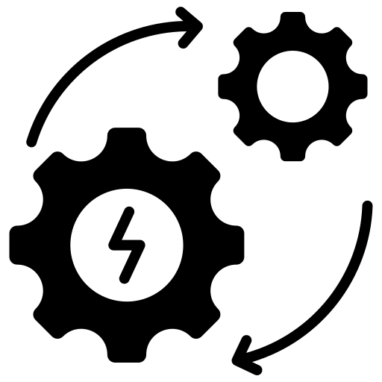

Mobile Application
Improved Propulsion System
01
Propellers design
Mechanical Optimization
Material
Redesign
02
Enhanced Power Management
Battery monitoring
Current protection
03

Slide 8


Areas of Improvements
Mobile
Application
Improved Propulsion System
04
Calibration interface
Troubleshooting
Autonomous navigation
01
Propellers design
Mechanical Optimization
05
Ease of Maintenance
Data recording
Material
Redesign
02
06
Enhanced Power Management
Modular design
Improved accessibility
Battery monitoring
Current protection
03
Notes:
As Christophe said there is a lot of possible improvement
IPS :
Redesign the hovercraft's propellers for optimal thrust.
Use symmetrical propellers to maximize efficiency.
MO :
Use lighter materials to reduce overall weight.
Redesign the skirt for better airflow distribution and stability.
EPM :
Implement real-time battery monitoring to track power usage.
Add current protection to prevent motor or ESC damage.

Slide 9
Areas of Improvements
Mobile
Application
04
Calibration interface
Troubleshooting
Autonomous navigation
05
Ease of Maintenance
Data recording
06
Modular design
Improved accessibility
Notes:
MA
Implementation of a motor and servomotor calibration interface
Addition of a diagnostic mode for troubleshooting
AN
Development of a feature for recording navigation data
EoM
Modular design for easy component replacement
Improved accessibility to critical components (especially the Arduino board)

Slide 10
Conclusion
Objectives achieved: Functional hovercraft prototype developed.
Solid foundation for future enhancements.
Future scope: Autonomous navigation and advanced control systems.
Notes:
To conclude, the main objective has been achieved. All the different functionalities work. Together, they don’t work perfectly, but the results are very satisfying considering the time we had.
Thus, for next year, there is a solid foundation, and the hovercraft is ready to be improved.
Finish with a demonstration

